Slide 1
Just-in-time data: Using real-time data visualization to combat COVID-19
Data Science Africa: COVID-19 Response Webinar, 8th April 2020
Osamai Osbert, CISA,COBIT
@osbertosamai
osbert.osamai@gmail.com
NITA-U Budget Framework Paper

Slide 2

THE COVID-19 PROBLEM
Points of Entry – Identifying high risk persons
Test Centers/Labs – Reporting of results
Monitoring of quarantines and tracing contacts
National communication – overrun call centers, uncoordinated information, fake news
Fragmented data sources/applications
Stretched situation room – long meetings etc.

Slide 3
INTERVENTIONS
Data Entry tools (web/mobile/USSD) and dashboards
Tracking PoEs/border points/Arrivals
Monitoring contacts
Daily tracking of quarantines
Chat bot – to ease call center traffic
Integration of data sources (APIs) – limit number of applications
Information portals/FAQs/Knowledgebase for call center
Fragmented data sources/applications

Slide 4
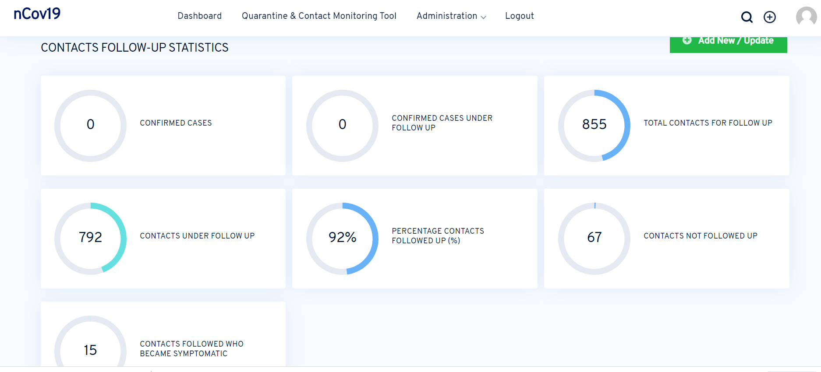
Dashboards

Slide 5
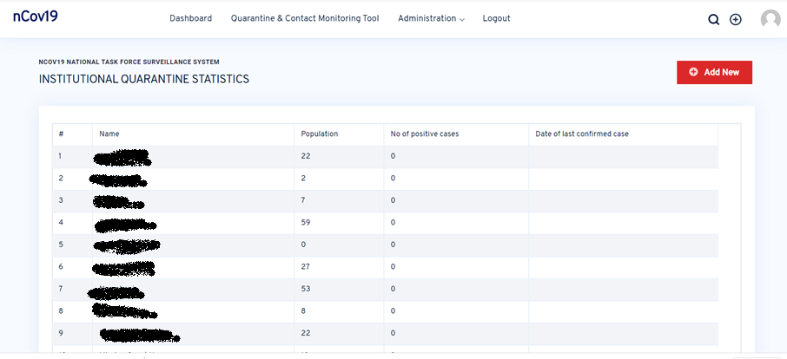
Dashboards - 2

Slide 6
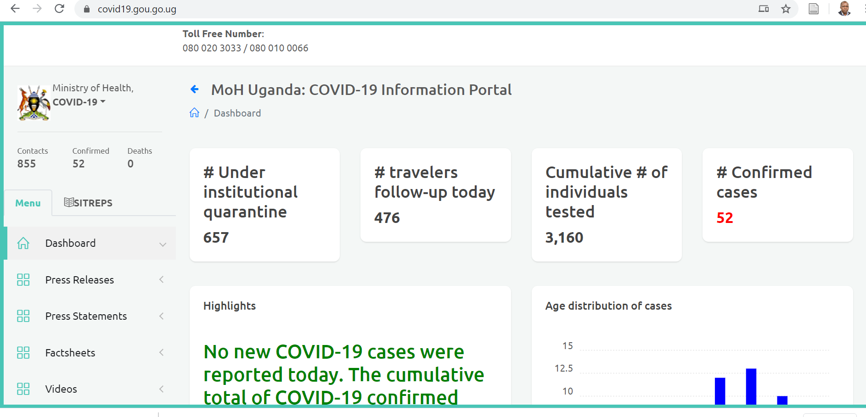
Dashboards - 2

Slide 7
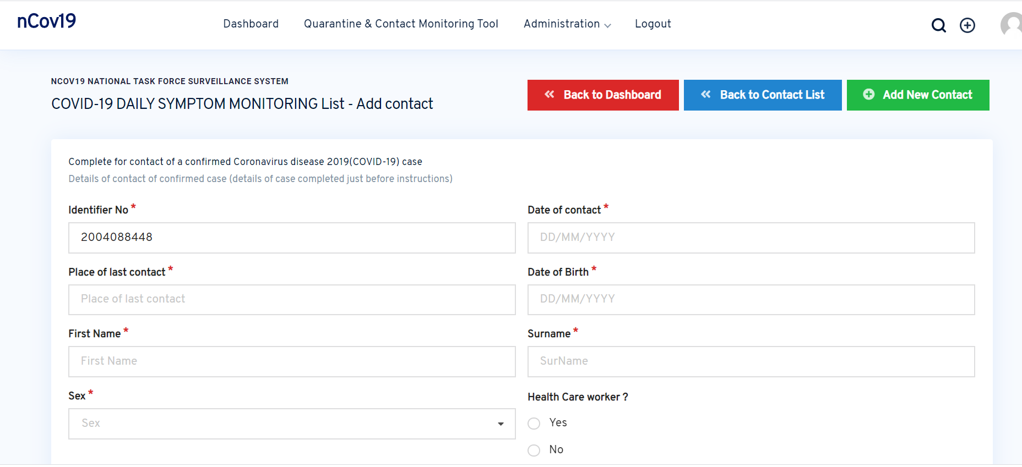
Data collection tool

Slide 8
Take away
Quick delivery/Devops
Integration of Systems
Coordinated teams
Scalable data products

Slide 9
Tools
Python/Django
PHP
JavaScript
SQL
Ionic/Mobile App

Slide 10
Links
https://covidadmin.gou.go.ug/
https://covid19.gou.go.ug/
https://health.go.ug

Slide 11
THANK YOU

